Slide 1
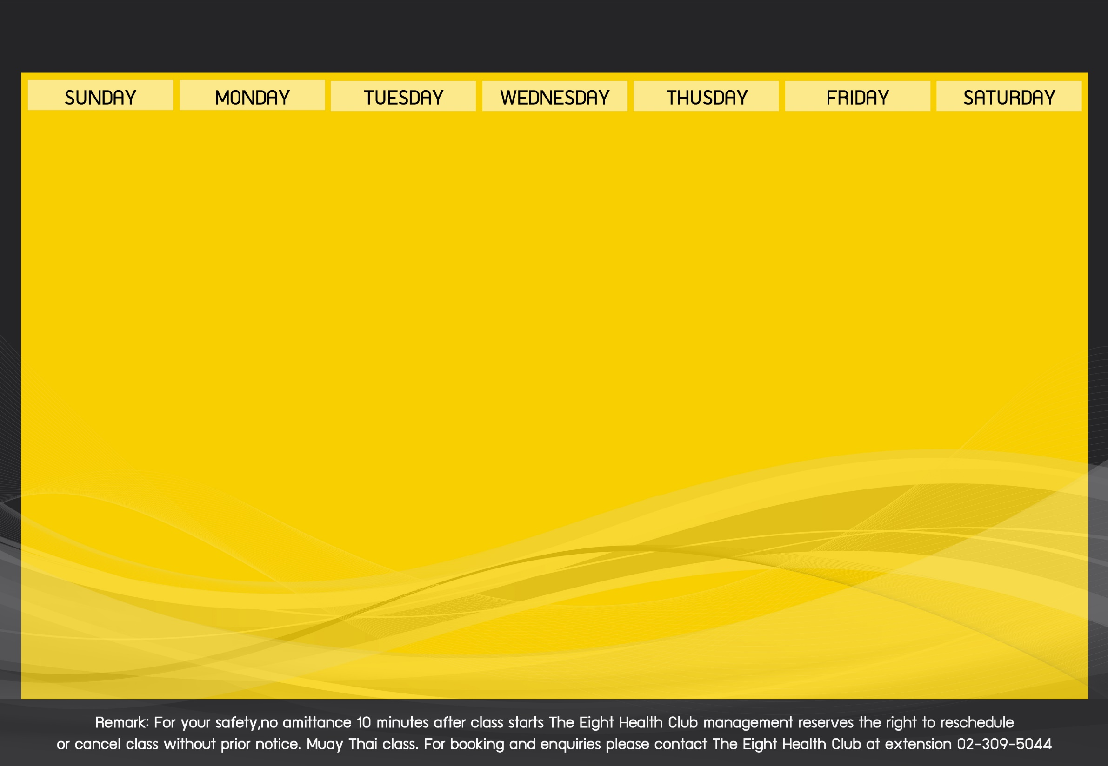
Activities Schedule of March 2019

