Slide 1
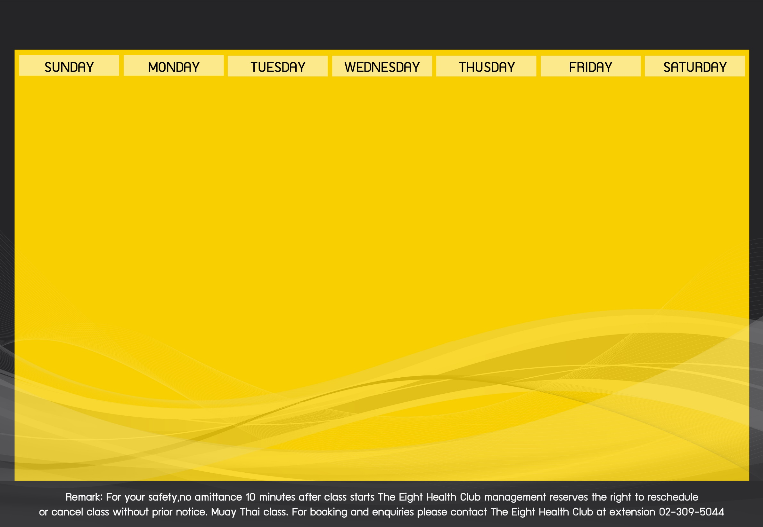
Activities Schedule of September 2018

