Slide 1
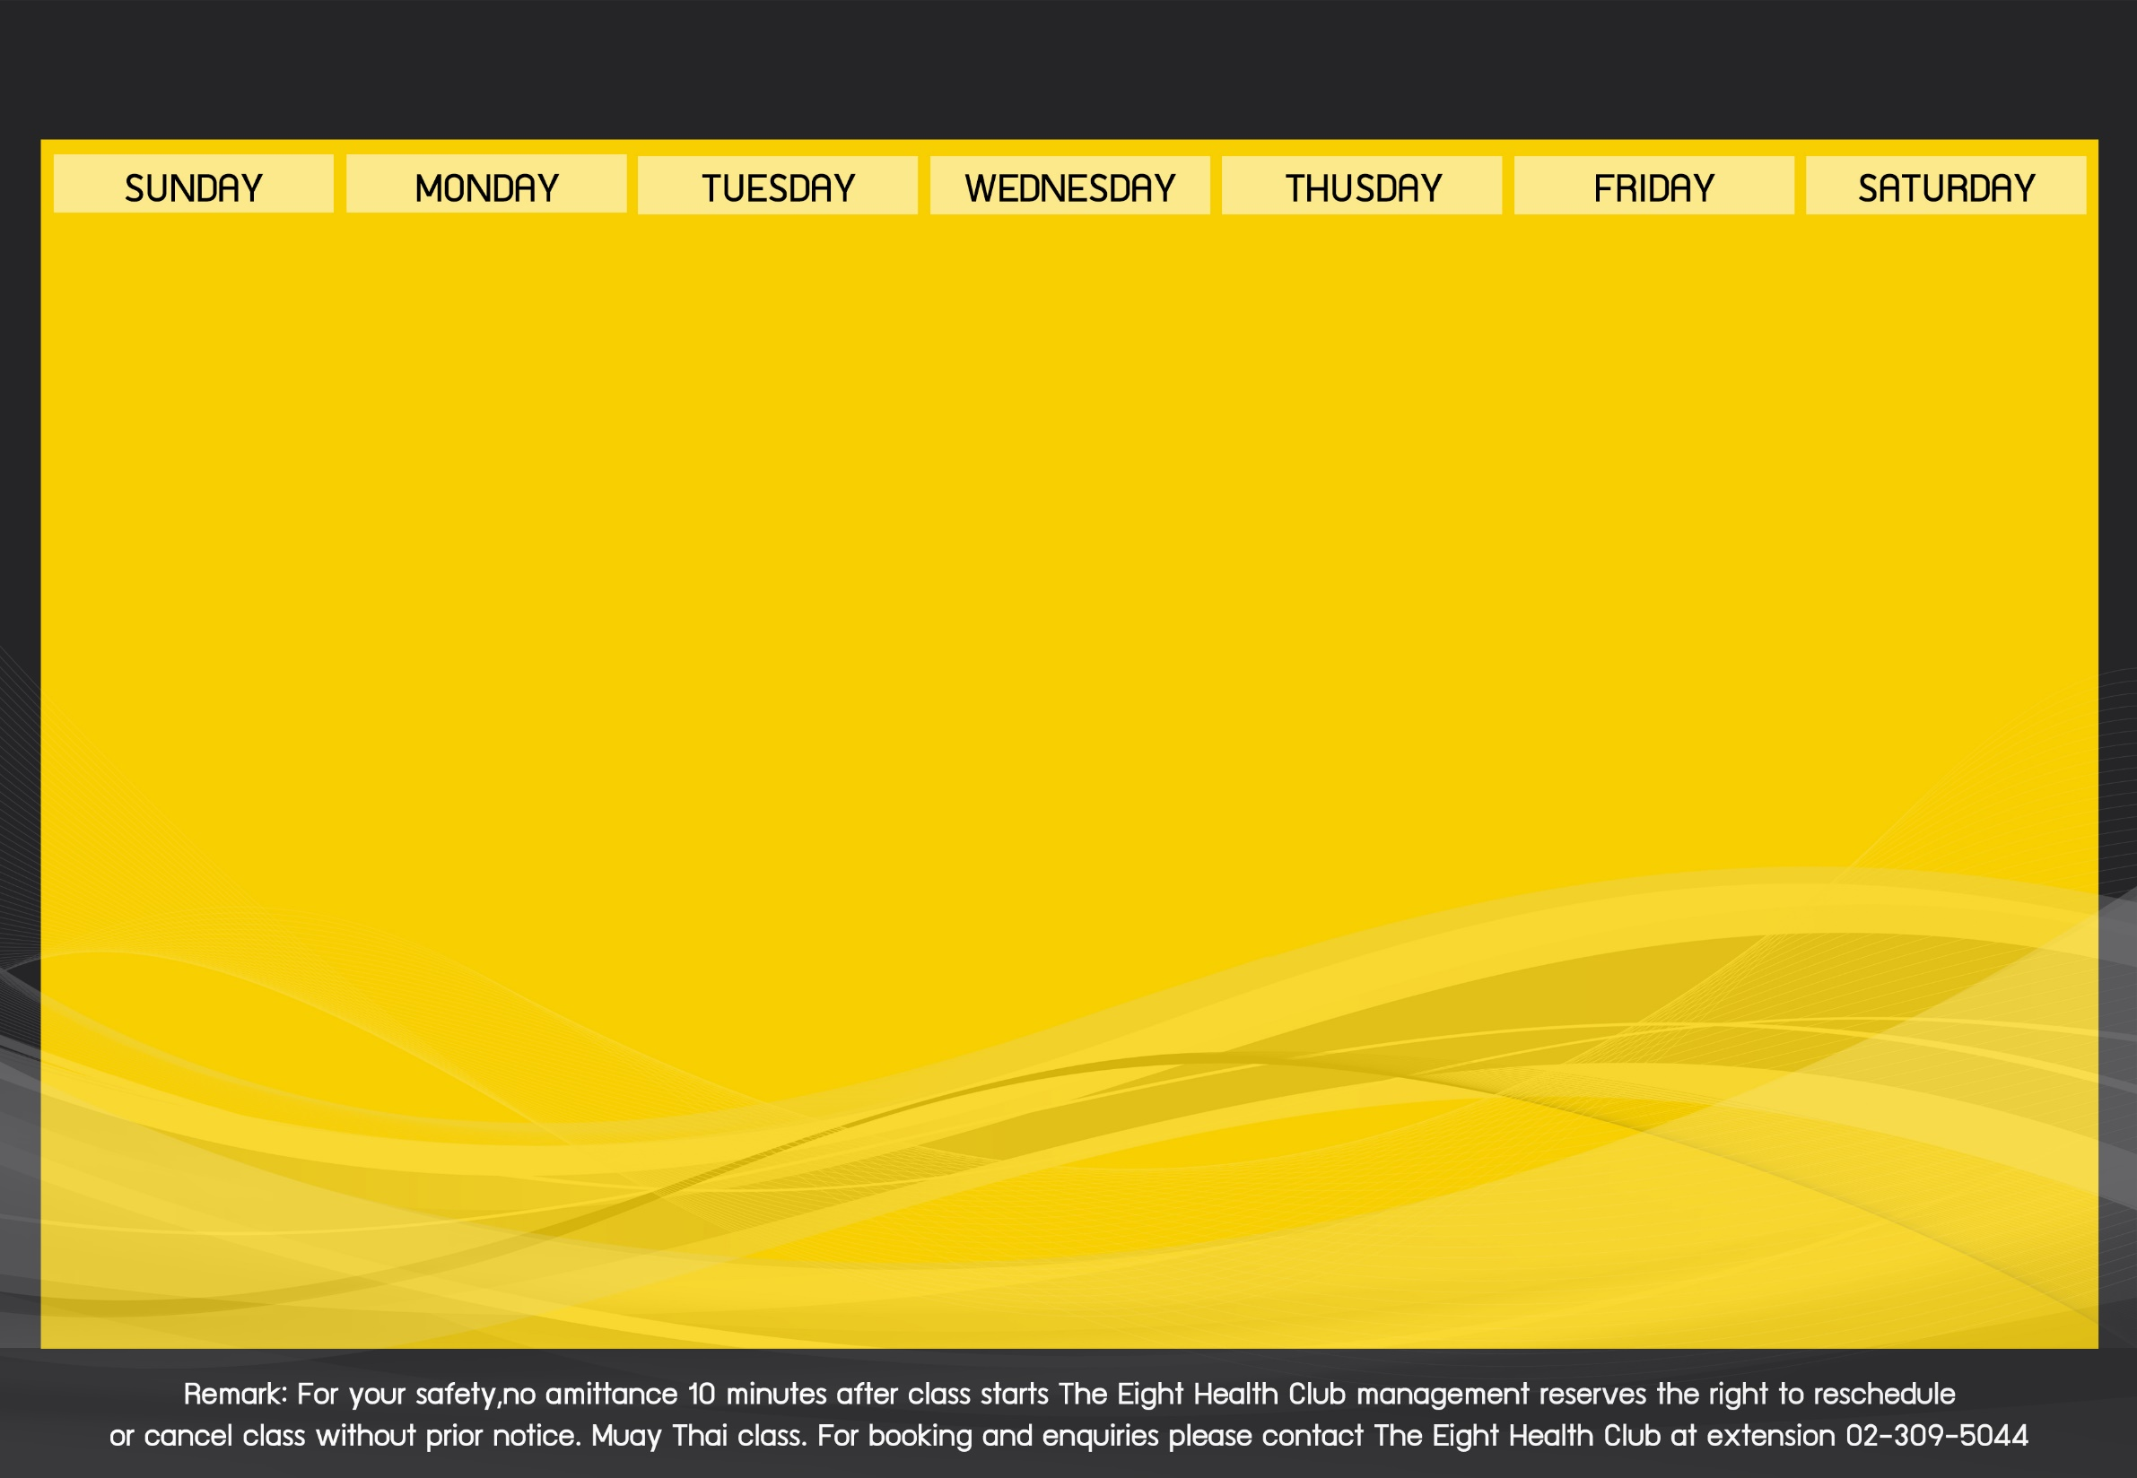
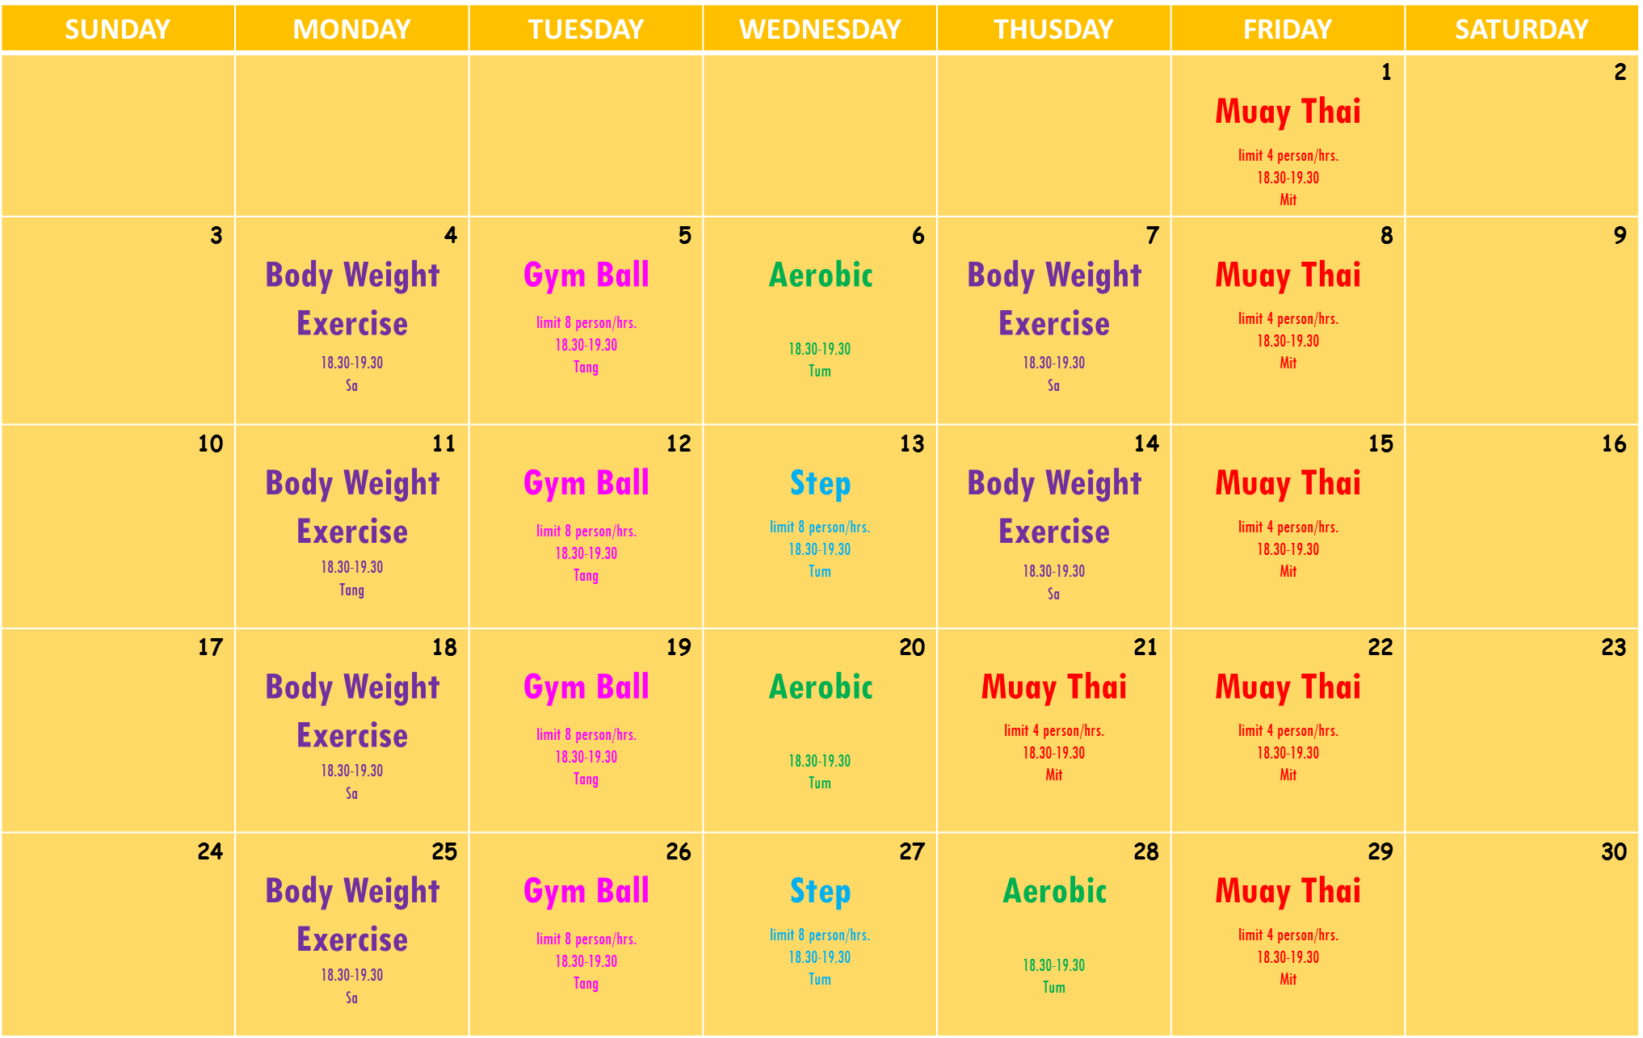
Activities Schedule of June 2018

Slide 2
SUNDAY | MONDAY | TUESDAY | WEDNESDAY | THUSDAY | FRIDAY | SATURDAY
 |  |  |  |  | 1 Muay Thai limit 4 person/hrs. 18.30-19.30 Mit | 2
3 | 4 Body Weight Exercise 18.30-19.30 Sa | 5 Gym Ball limit 8 person/hrs. 18.30-19.30 Tang | 6 Aerobic 18.30-19.30 Tum | 7 Body Weight Exercise 18.30-19.30 Sa | 8 Muay Thai limit 4 person/hrs. 18.30-19.30 Mit | 9
10 | 11 Body Weight Exercise 18.30-19.30 Tang | 12 Gym Ball limit 8 person/hrs. 18.30-19.30 Tang | 13 Step limit 8 person/hrs. 18.30-19.30 Tum | 14 Body Weight Exercise 18.30-19.30 Sa | 15 Muay Thai limit 4 person/hrs. 18.30-19.30 Mit | 16
17 | 18 Body Weight Exercise 18.30-19.30 Sa | 19 Gym Ball limit 8 person/hrs. 18.30-19.30 Tang | 20 Aerobic 18.30-19.30 Tum | 21 Muay Thai limit 4 person/hrs. 18.30-19.30 Mit | 22 Muay Thai limit 4 person/hrs. 18.30-19.30 Mit | 23
24 | 25 Body Weight Exercise 18.30-19.30 Sa | 26 Gym Ball limit 8 person/hrs. 18.30-19.30 Tang | 27 Step limit 8 person/hrs. 18.30-19.30 Tum | 28 Aerobic 18.30-19.30 Tum | 29 Muay Thai limit 4 person/hrs. 18.30-19.30 Mit | 30

