Slide 1
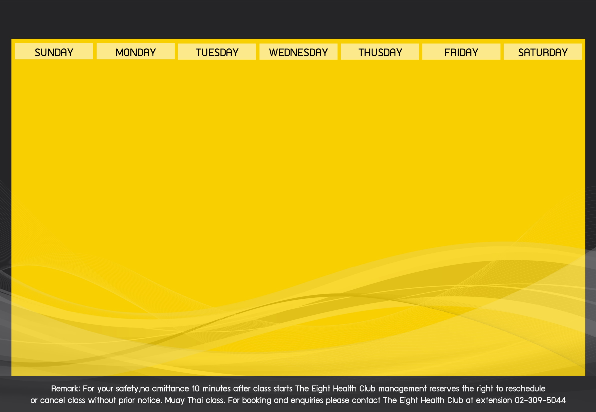
Activities Schedule of October 2018

